Slide 1

Employee Data Analysis using Excel
STUDENT NAME: ROHINI J REGISTERNO:02C04992FE88F7A82564CB0DEDE3D381,122201847 DEPARTMENT: B.COM(CORPORATE SECRETARYSHIP)
COLLEGE: MEENAKSHI COLLEGE FOR WOMEN
1

Slide 2

PROJECT TITLE
EMPLOYEE PERFORMANCE BASED ON JOB LEVEL AND WORK LIFE BALANCE ANALYSIS.
2

Slide 3



AGENDA
1.Problem Statement 2.Project Overview 3.End Users 4.Our Solution and
Proposition
5.Dataset Description
6.Modelling Approach
7.Results and Discussion
8. Conclusion
3/21/2024 Annual Review
3

Slide 4


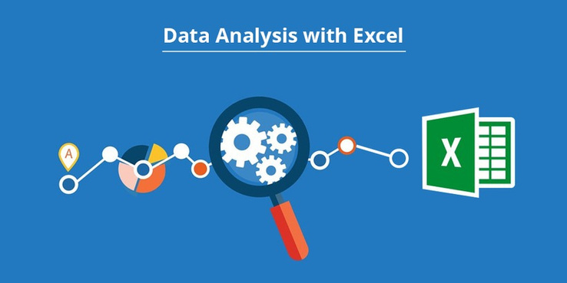
PROBLEM STATEMENT
Analyze Data in Excel empowers you to understand your data through natural language queries that allow you to ask questions about your data without having to write complicated formulas. In addition, Analyze Data provides high-level visual summaries, trends, and patterns.
4

Slide 5
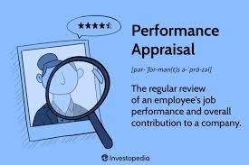
PROJECT OVERVIEW
An employee performance review summary is a brief overview of an employee's performance, strengths, and areas for improvement. It should include a brief explanation of what the employee does well and what they could improve, along with advice on how to improve.
5

Slide 6
WHO ARE THE END USERS?
● HUMAN RESOURCE DEPARTMENTS ● MANAGEMENT AND LEADERSHIP ● TEAM LEADERS AND SUPERVISORS ● EMPLOYEES ● EXECUTIVE LEADERSHIP ● BUSINESS ANALYSTS ● RECRUITERS
6

Slide 7

OUR SOLUTION AND ITS VALUE PROPOSITION
FILTERING - REMOVEVALUES PIVOT TABLE - SUMMARY OF WORK LIFE BALANCE ANALYSIS FLOW DIAGRAM - FINAL REPORT
7

Slide 8

Dataset Description
EMPLOYEE DATA SET- KAGGLE
● 20 FEATURES IN EXCEL: EMPLOYEE ID- ALPHANUMERIC(TEXT) NAME- ALPHABETICAL(TEXT) AGE-NUMERICAL(TEXT) GENDER- ALPHABETICAL(TEXT) MONTHLY INCOME -NUMERICAL(TEXT) JOB ROLE - ALPHABETICAL(TEXT) WORK-LIFE BALANCE -ALPHABETICAL(TEXT) JOB SATISFACTION-ALPHABETICAL(TEXT) PERFORMANCE RATING- ALPHABETICAL(TEXT) NUMBER OF PROMOTIONS - ALPHANUMERICAL (TEXT) DISTANCE FROM HOME - ALPHABETICAL(TEXT) EDUCATIONAL LEVEL - ALPHABETICAL(TEXT) MARITUAL STATUS - ALPHABETICAL(TEXT)

Slide 9

JOB LEVEL - ALPHABETICAL(TEXT) COMPANY SIZE-ALPHABETICAL(TEXT) COMPANY TENURE - ALPHABETICAL(TEXT) REMOTE WORK - ALPHABETICAL(TEXT)
LEADERSHIP OPPORTUNITIES - ALPHABETICAL(TEXT) INNOVATION OPPORTUNITIES- ALPHABETICAL(TEXT) COMPANY REPUTATION - ALPHABETICAL(TEXT) EMPLOYEE RECOGINITION - ALPHABETICAL (TEXT).
3 FEATURES USED: SUM OF COMPANY TENURE - NUMERICAL(TEXT) JOB LEVEL - ALPHABETICAL(TEXT) WORK-IN BALANCE - ALPHABETICAL(TEXT)

Slide 10

THE "WOW" IN OUR SOLUTION
Empirical results demonstrate that work-life balance positively influences jobsatisfaction and performance. Our empirical findings also revealed that jobsatisfaction partially mediates the relationship between work-life balance and job performance.
3/21/2024 Annual Review
9

Slide 11

MODELLING
● STEP-1 THE EMPLOYEE DATASET HAVE BE DOWNLOADED FROM KAGGLE WEBSITE. ● STEP-2 OPEN THE EMPLOYEE DATASET IN THIS EXCEL. ● STEP-3 FILTER FTP FROMAT ORDER. ● STEP-4 SELECT THE ENTIRE DATA AND CLICK ON INSERT AND CLICK ON PIVOT TABLE TO CREATE PIVOT TABLE.
10

Slide 12
● STEP-5 DRAG THE NEED END DATA AND CREATE A PIVOT TABLE. ● STEP-6 SELECT THE PIVOT TABLE AND CLICK ON INSERT. ● STEP-7 NOW CLICK ON THE CHART THAT YOU WANT. ● STEP-8 THE CHART IS CREATED.
10

Slide 13
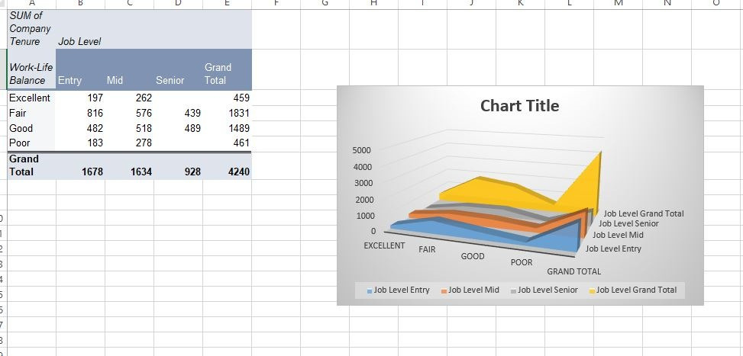
RESULTS 1.TABLE
11

Slide 14
2.BAR DIAGRAM
11

Slide 15
Conclusion
The service sector, especially thebanking sector, has issues relatedtowork-life balance.Given its importance, we collected datafromthe local privatebanks on the different aspects of work-lifebalance. We foundthatwork-life balance promotes jobsatisfaction andpsychological well-being. Andjobsatisfaction and psychological well- beingare precursors ofjob performance.Psychological well-being mediateswork-life balance andjob performance.

